Slide 1
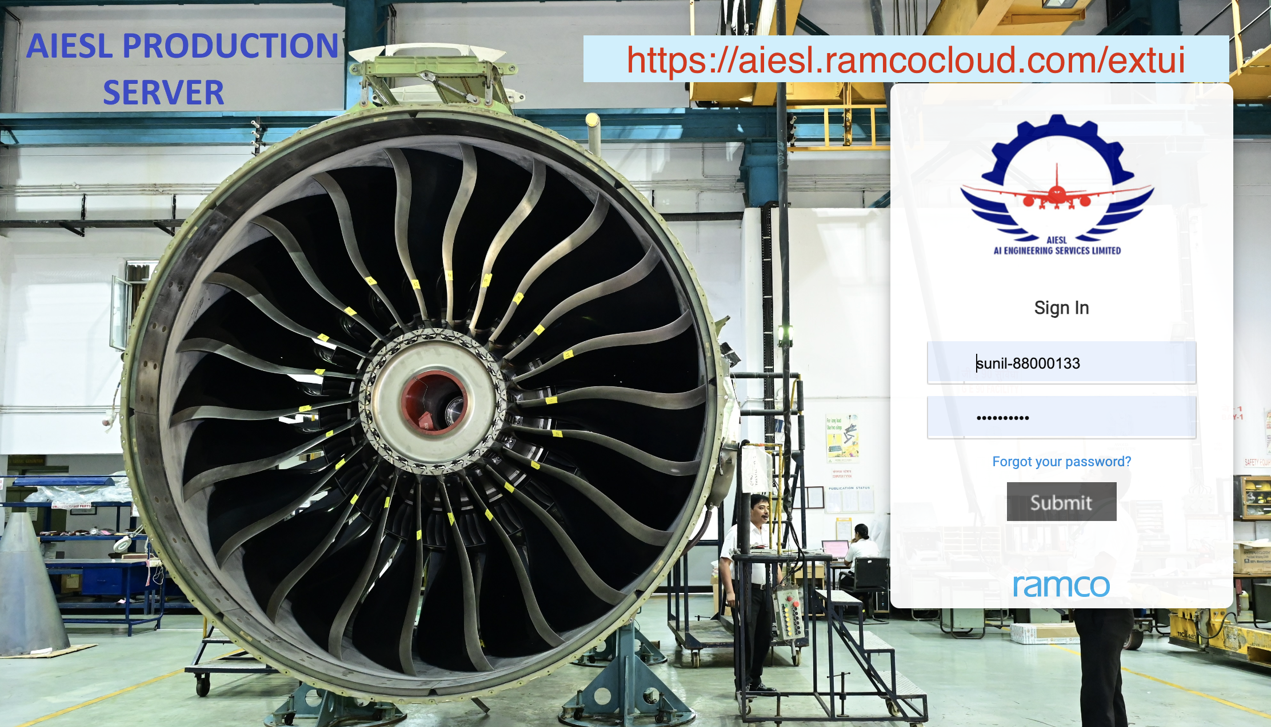
Ramco MRO Online Workscope
22 JAN 2024, Version 2.0
—Sunil Kumar
AGM(B2), Base Maintenance, AIESL, IGI Airport, T2, N. Delhi
—Surendra Behal
DGM, Safderjung Airport, AIESL, N. Delhi

Slide 2
Revisions:
Revision No. | Reason for Change
Version 1.0, 06 Nov 2023 | Ramco Go Live Event. Ref no. AIESL/ED/2023/190 Dated Nov 02, 2023.
Version 1.3*, 18 Nov 2023 | Changes in URL Home Page(AIESL logo), Material Request Procedure and the discontinuation of component transaction under Misc. Option and accomplishing it as Other parts.
Version 1.4, 30 Nov 2023 | Air India Inspection Notice, AI IN-00/02, 28 Nov ’23, AMOS Implementation: Streamlining Maintenance Processes.
Version 2.0, 22 JAN 2024 | SOP revised to ease out component transaction updation in AIESL RAMCO
*Note: Each Change accounts to an increment in the first decimal place in the version number.
Three changes mean increment by 0.3.

Slide 3
References:
“AIESL Ramco Go-Live,” Ref no. AIESL/ED/2023/190 Dated Nov 02, 2023.
Air India Inspection Notice, AI IN-00/02, 28 Nov ’23, AMOS Implementation: Streamlining Maintenance Processes.
SOP/Issue 1/Rev 4 dated 22-01-2024

Slide 4
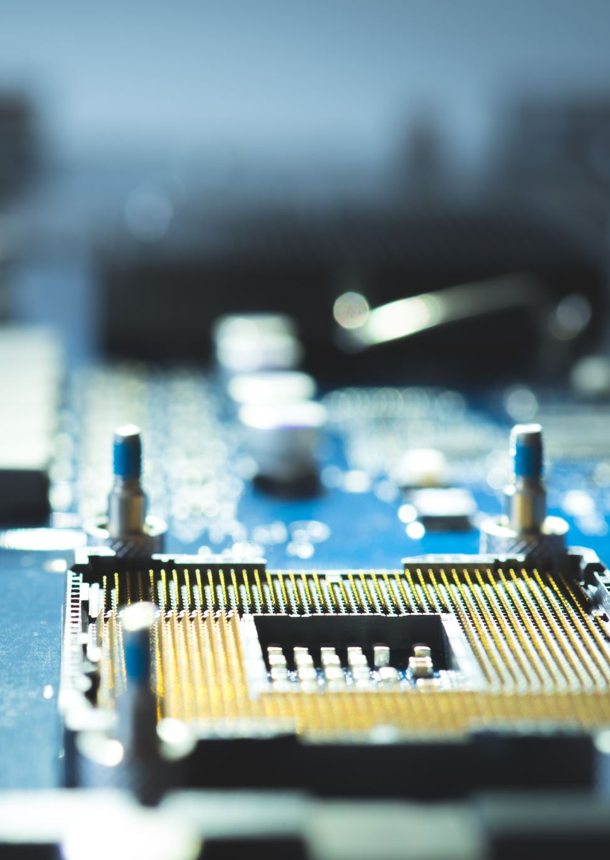
Abbreviations :
URL: Uniform Resource Locator. A URL is the address of a given unique resource on the Web. Simply, it’s the web-address for a site.
MDCC: Master Data Control Center, authorized for business process master data control.
MRO: Maintenance, Repair and Overhaul.
SAP: Systems Applications and Products in Data Processing. SAP, by definition, is also the name of the ERP (Enterprise Resource Planning) software as well as the name of the company.
SIC: Shift In-Charge
MRF: Material Request Form
SOP: Standard Operating Procedure
CR: Component Replacement; PPCR: Piece Parts CR
Misc.: Miscellaneous; an option of transaction for components without any component ID in Ramco. This option produces least foot-prints viz., AMRN, CR, PPCR in the system
MSN: Manufacture S/No.
CGR: Customer Goods Receipt
AMRN: Aircraft Material Return No.
Air India Ramco Server: mro.airindia.com
AIESL Ramco Server: aiesl.ramcocloud.com/extui
| Vertical bar: highlights the revised content.
DFP: Dirty Finger Print

Slide 5
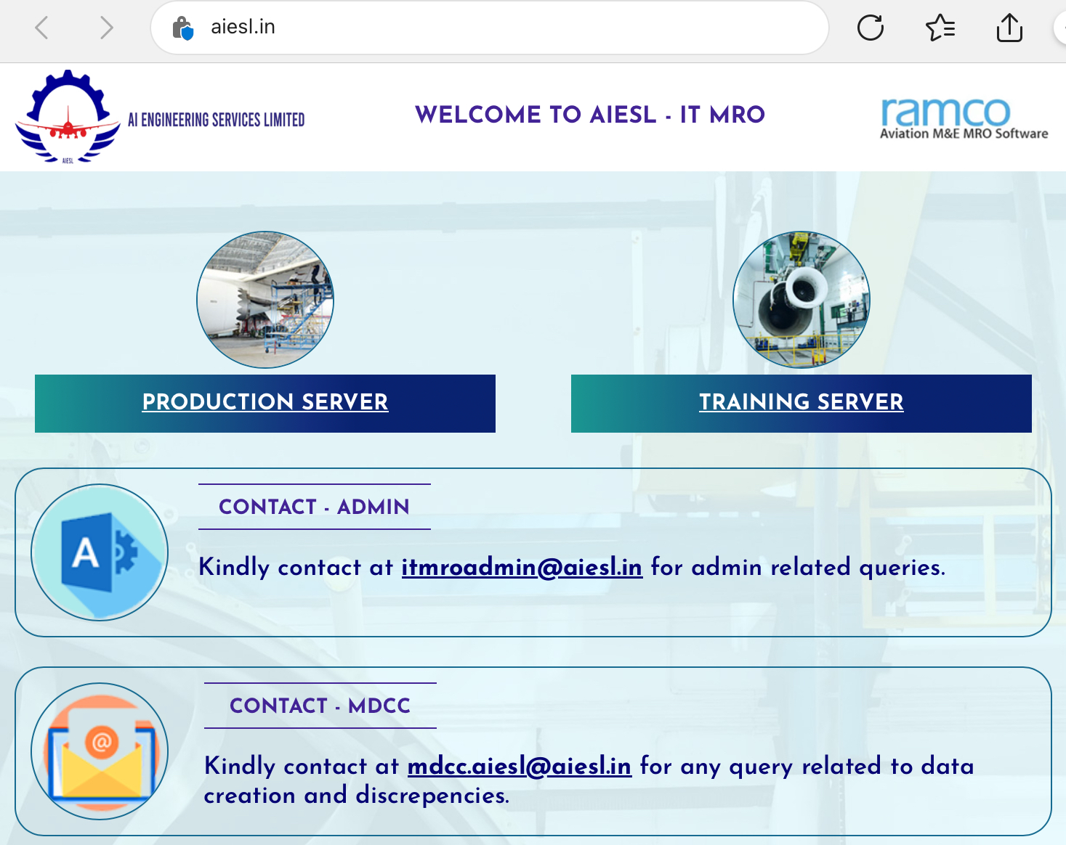
Production Server:
www.aiesl.in/ramco
Or, https://aiesl.ramcocloud.com/extui

Slide 6
Our Goals
Plugging the systemic lapses existing in MRO Activities and bringing them to a level of perpetuity where everything runs smoothly and autonomously keeping us off fire fighting in the last minute.
The implementation of final invoicing/billing in its true spirit.
Digital Data Feeding enhancing the data search and analytical capabilities subsequently developing decision-making strategies
Simplification of documentation work as an MRO to expedite the work.

Slide 7
Master Data Control Center (MDCC)
Maintaining different business processes master data.
Creation / modification in master data
MDCC Team
mdcc.aiesl@aiesl.in
contact

Slide 8
Ramco + SAP = Customer Billing–>OUR SALARIES
All the users to transact all the MRO work in the Ramco System.
Record any additional work in Ramco discrepancies alongside booking of manhours for additional(discrepancies) work.
Ramco
SAP
Customer Billing
Feeding + Upload
Customer Invoice
Final
Uploading of scans of P/R, Techlog, CRS, NRCs against the package
Revenue/ Our Salaries
Authorized customers can download it
*
*View user login v.user-111111 has been created in
AIESL RAMCO (URL: https://aiesl.ramcocloud.com/extui)
for operators to check the status of package/wo
and download the attached package scan.

Slide 9
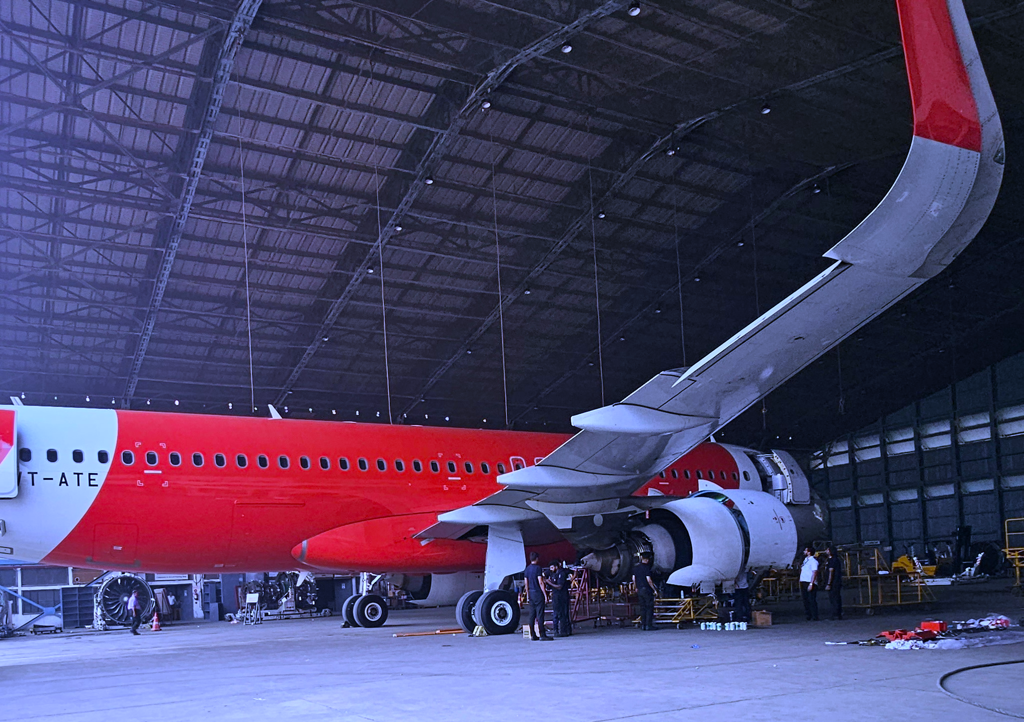

Future Upgrade 5.9.3
Customer can view and download their packages.
Package compliance scan within 1 day: for Line Maint. Packages.
Package compliance scan within 3 days: for Heavy Maint. Packages.
Senior most SIC /AME responsible for the closure of packages within timeline per MSA.
In case of any noncompliance or delay in closure of packages Enforcement Action is vested with the departmental head.

Slide 10
SOP Component Replacement: Air India/AI Exp/other 3rd Parties
Material Request Form(MRF, left side).
AIESL MRO personnel will get all the components issued by Air India itself through a request made using the MRF. Such an MRF form can be sent by email.
👈🏻 Note:- Find the Landscape MRF sheet in the section: USEFUL FORMS, at the end.

Slide 11
Component Replacement to be updated in discrepancy —AI/AI Exp/ 3rd parties
In the new Ramco, there is no components’ configuration of the airplanes owned by AI / AI Exp / 3rd parties, so we need to provide component replacement details (P/N, OFF# ON#) in discrepancy corrective action and generate discrepancy report and sign.
This will simplify the transactions and reduce the time incurred searching the items from the configuration of the airplane.
No MR, No CR, No PPCR, No MRN for component issued by operator
However, if component issue from AIESL store and belong to AIESL then MR,CR/PPCR, MRN to be carried out.

Slide 12
U/S Component Manual Tag using FTM U/S tag Form
Use FTM U/S tag format fill all details and sign and handover item with tag to progress.
Ensure P/N,S/N removal position, removal date, reason for removal, removed from A/C or P/N,AIESL work order, operator work order are mentioned on tag.
ALSO WRITE PACKAGE NO. ON THE TECHLOG PAGE APPROPRIATELY.

Slide 13
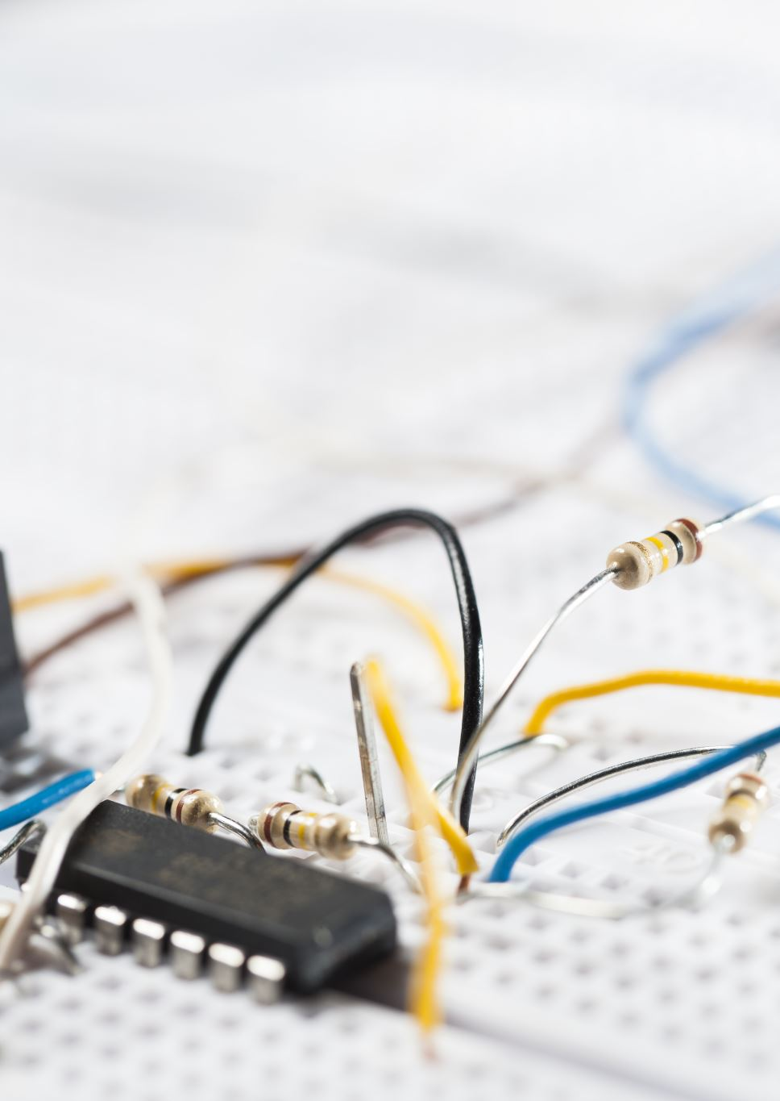
Component Replacement
Component P/N OFF# ON# should be entered in discrepancy. This is applicable for part issued by operator. In case of part issued from AIESL store earlier procedure of MR,CR/PPCR, MRN to be used.
OFF P/N & S/N to be entered in discrepancy multiline detailed view. This will be used for generating removal tag from system when specific report for this will be developed soon.

Slide 14

Invoking and Revoking MEL Entries in Ramco– AI/AI Exp/ 3rd Parties
As we are not monitoring the deferred entries of the above clients, we will treat every MEL entry as a plain discrepancy update action taken and close. Revoking or further C/F should also be entered as discrepancy and close it after updation of action taken.

Slide 15

DRDO and SESF Compo Replacement
Configuration for DRDO & SESF Aircraft will be maintained in the system, so component replacement procedure will remain on As-Is basis practice.
Items for DRDO and SESF will be procured by AIESL and managed in the AIESL store, so component replacement will require transactions i.e. MR, CR/PPCR,MRN, MIS etc. per current practice.

Slide 16
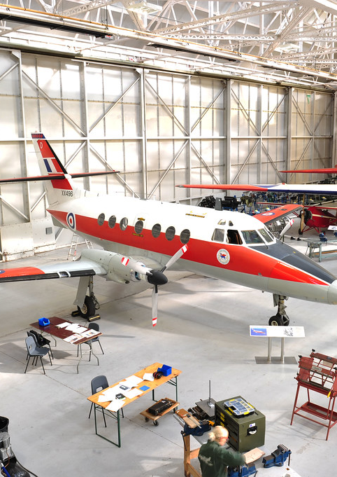
SOP for heavy check package generation in AIESL RAMCO MRO server
0. Airlines package should be entered in LOG REF while creating Package in AIESL Ramco for invoicing into our system.
1. Heavy check package will be created from Aircraft Execution Hub based on the package details as received from Air India CAMO/third party operators/DRDO/SESF.
2. Main ‘A’ check task will be planned in the package. All additional work and component replacement should be raised as discrepancy along with man hours booking for these discrepancies.
This Photo by Unknown Author is licensed under CC BY

Slide 17

3. In case any task requires deferral after taking concurrence from operator, then this task should be added in package as discrepancy and deferral recorded in action taken part and discrepancy closed in the system.
4. All EOs as received from Air India CAMO will be raised in the package as discrepancy and NRC report will be generated for each such task from RAMCO system.
5. Work monitoring screen will be used for recording man hour for each NRC(additional work) carried out in A Check.

Slide 18
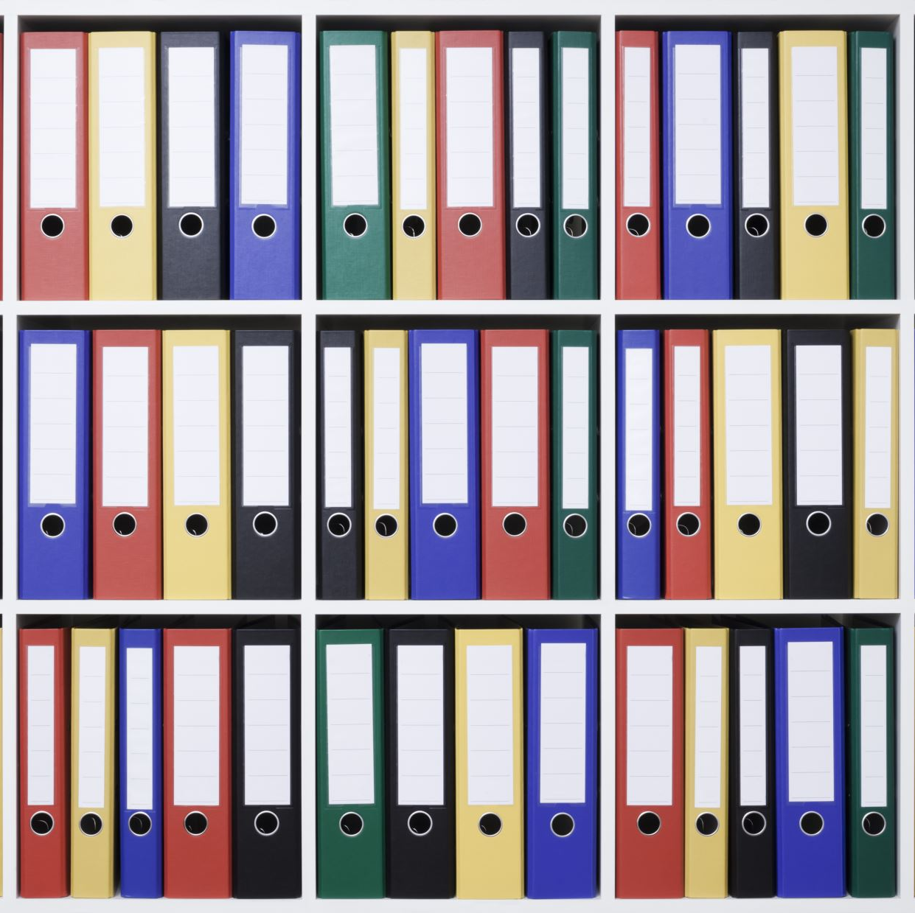
6. All task compliance date/time will be re-verified so that it is same as physical document.
7. CRS (CoM , Certificate of Maintenance) Report will be generated from the system after completion of package.
8. Scan of Package documents excluding JOB cards will be uploaded using upload document link from the package.

Slide 19
Present Issues:
Internet speed and bandwidth issues peculiar to the Ramco in Delhi.
Prospective Solution: As per Sh. Achal Sharma, Dy GM, IT-MRO, the new bidder will upgrade the IT infrastructure especially the LAN in our premises, T3, T2.
Fast moving parts i.e. wheels , oxygen bottles’ earlier transaction not updated in timely manner resulting in difficulty carrying out current transaction.
RAMCO error messages due unknown reason being taken up with RAMCO thru RTRACK system

Slide 20
Good ITMRO Practices
Normal Transactions
DRDO/SESF: Avoid forced replacements, as it generates Spurious AMRNs, which are not regularized easily.
Seal Beams
Scrap locally to FOD Bins. Update in discrepancy.
{Filters, life vests, packings, brackets}
Handover to Progress in whatever condition.
Warranty Claims, CID
Remove components with due care, else warranty claims not honored..
Leave packages up to Completed stage if the components transactions fail to update.
Packages must be closed only after completing all the components or additional jobs/EO’s.
Windshield cleaning is an additional job, must raise discrepancy for the same.
except

Slide 21
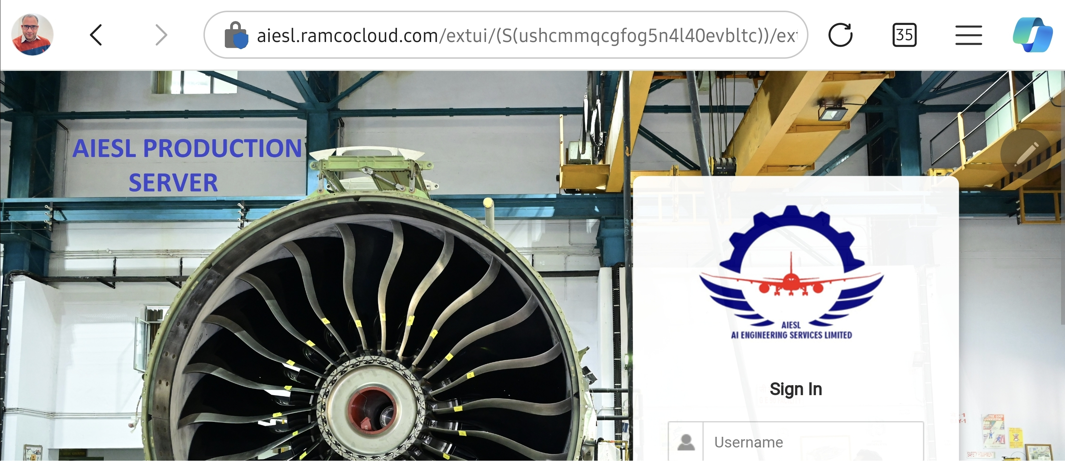
Https://aiesl.ramcocloud.com/extui

Slide 22
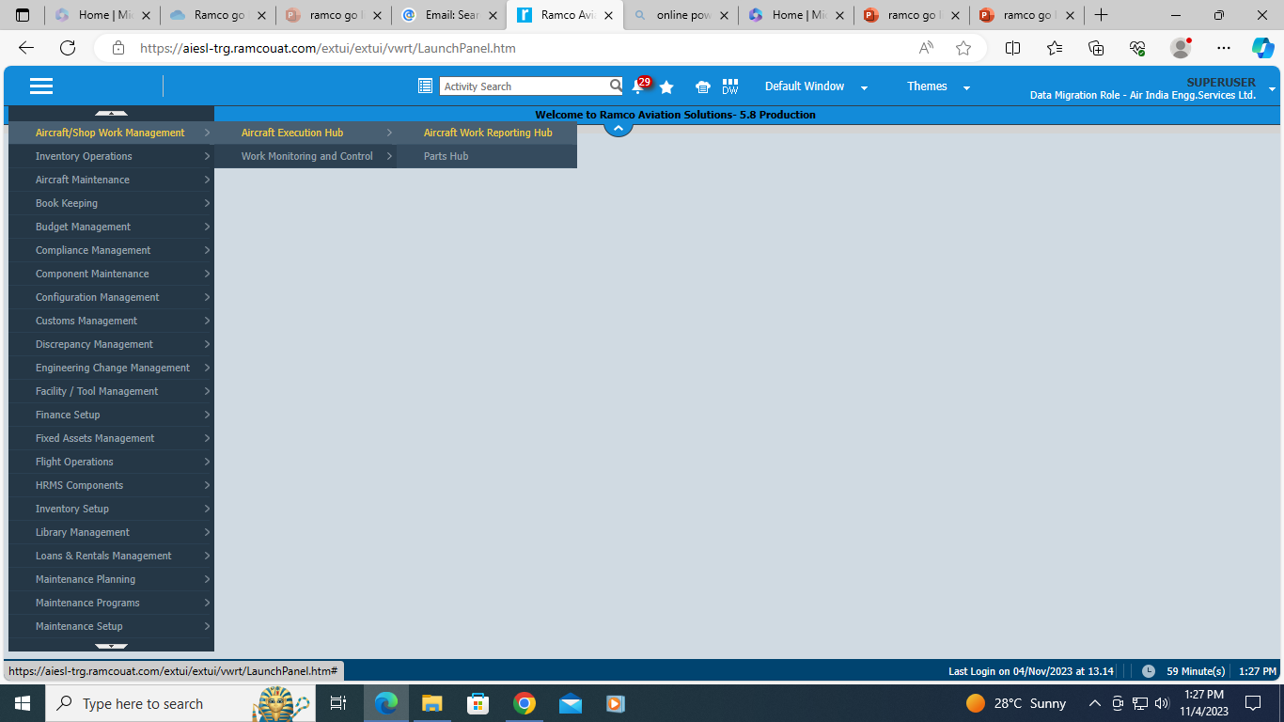
Practical: Creation of Work Package and feeding journey details

Slide 23
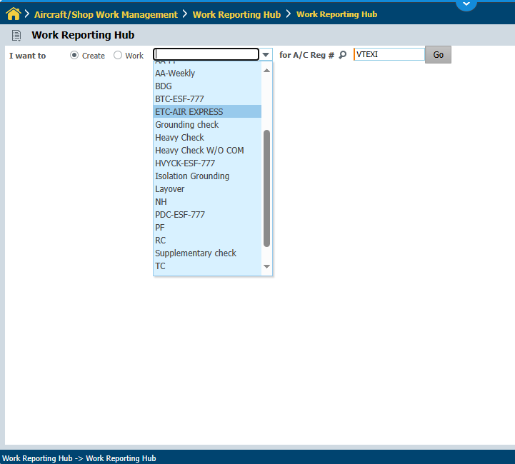
Select the type of package to be opened from the dropdown.
Say, PF

Slide 24
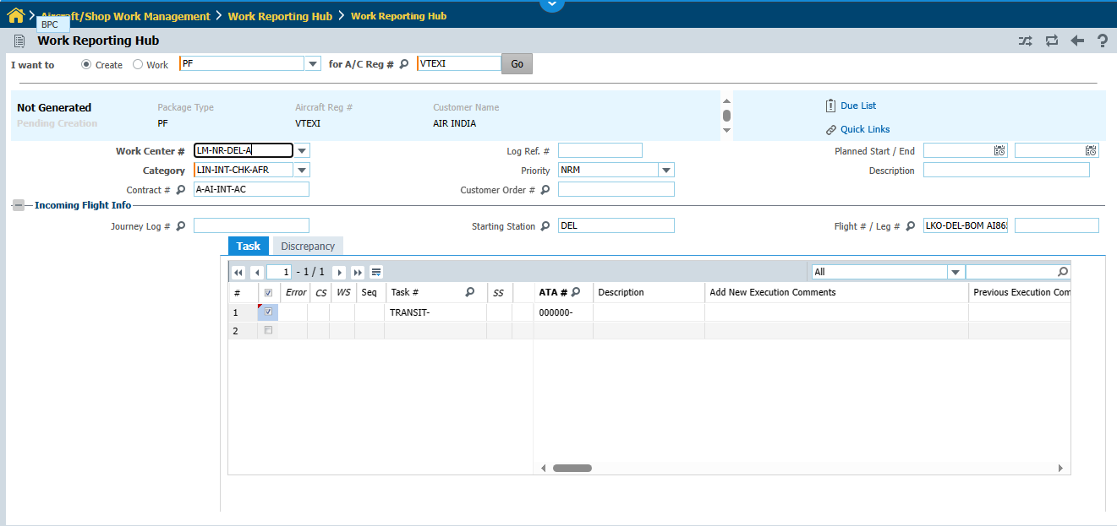
Write the A/C call sign and press Go
Note: Please enter LOG Ref. # for internal tracking by the customer/AI/ Third Party
Operator Package number, say AMOS Package
Select from the dropdown
EXI/H-24
inbound-transit-outbound Flt no.
Provide these data
Use lens and Select the task say Transit for a320-251 series,
SEE NEXT SLIDE
Press this at the bottom
CREATE PACKAGE

Slide 25
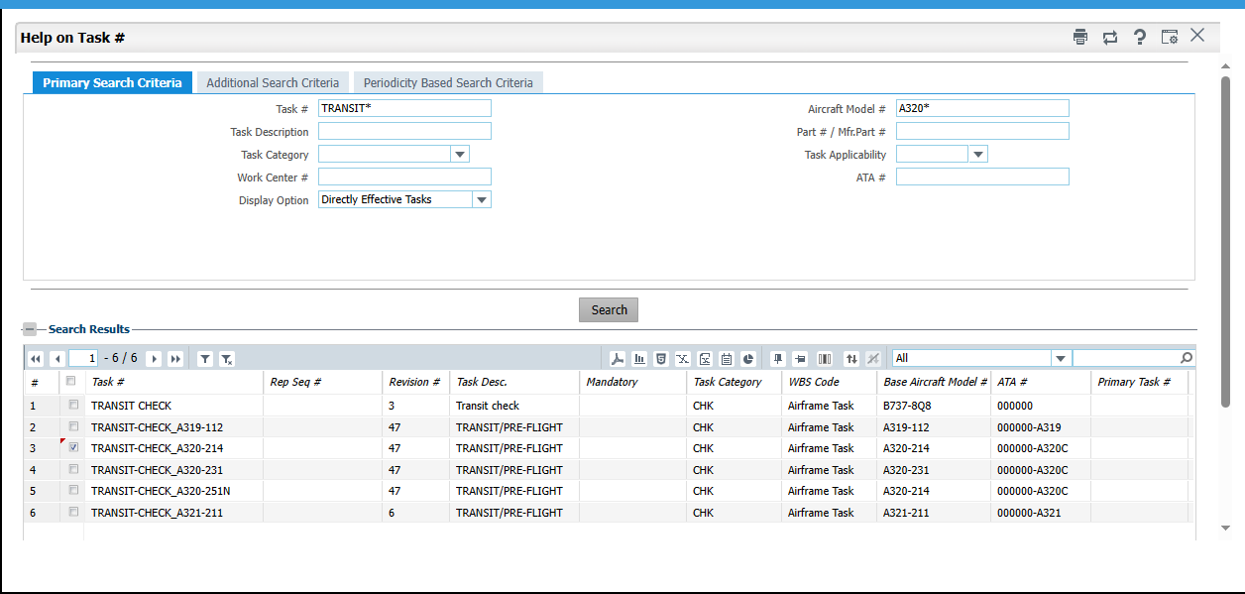

Slide 26
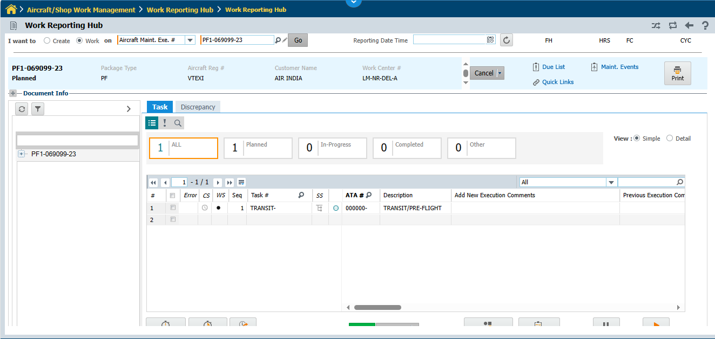
PACAKGE NUMBER GETS CREATED

Slide 27
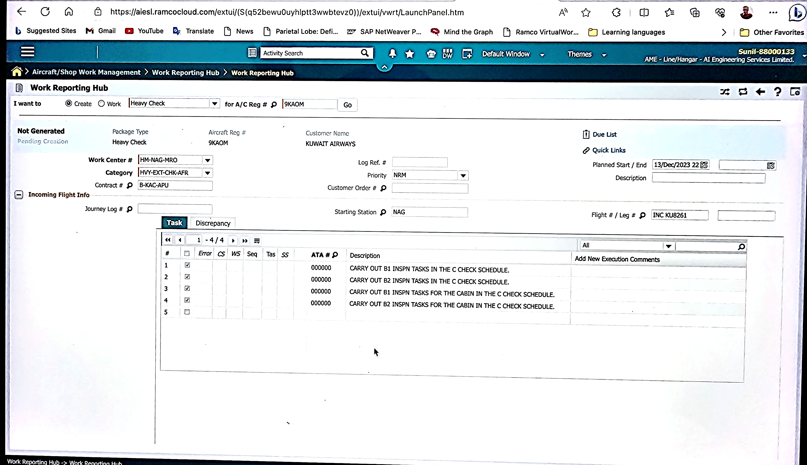
Single Line Compliance in case the Tasks are missing for a new Fleet
Create a task for a scheduled check and enter scheduled check c/o detail in execution
and close.

Slide 28
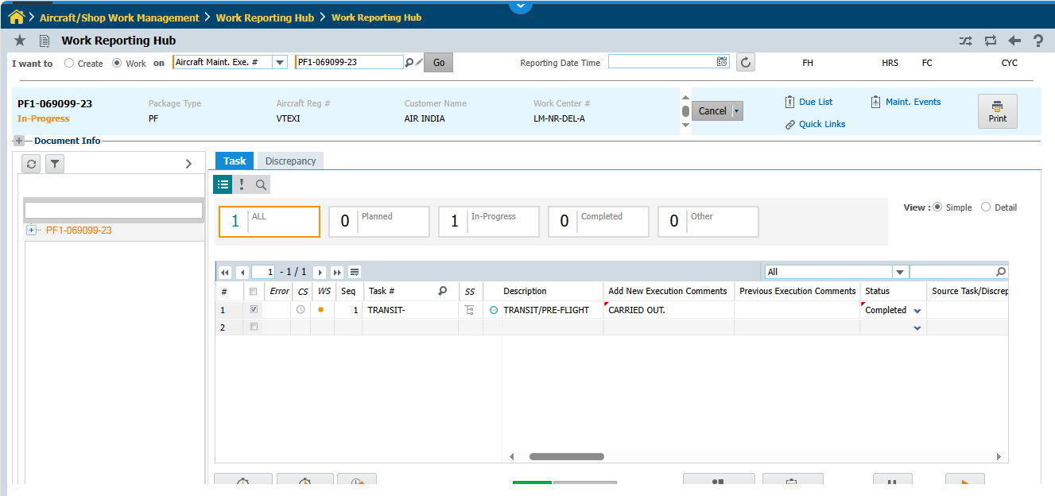
Subsequently use this for Discrepancy creation, if required
write execution comments

Slide 29
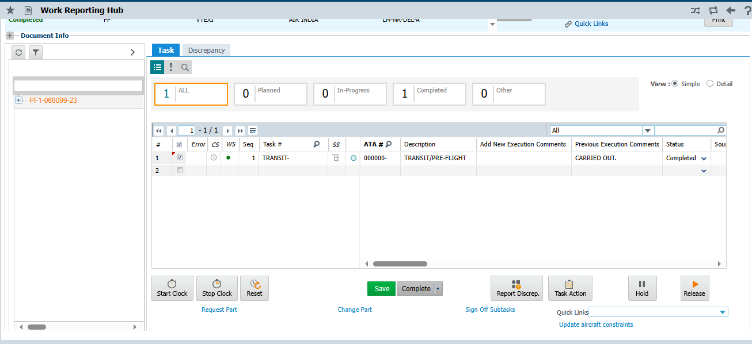
use any one of them for Completing the task

Slide 30
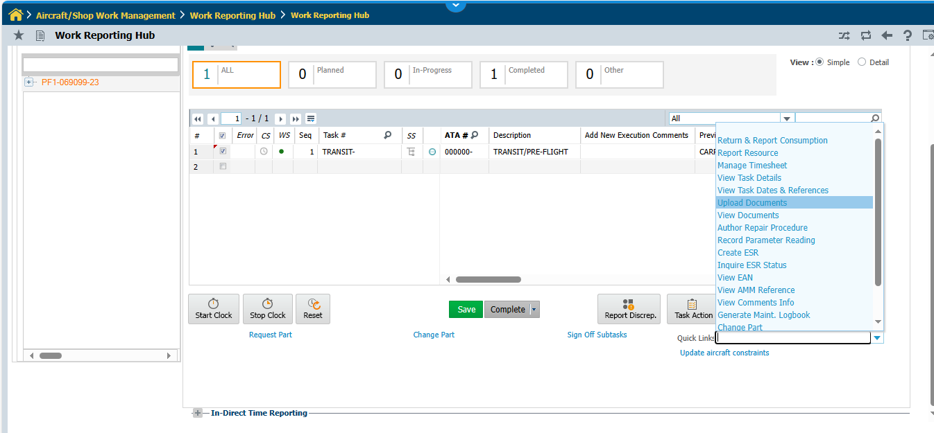
UPLOAD DOCUMENTS CORRESPONDING TO A TASK OR DISCPNCY
Select this

Slide 31
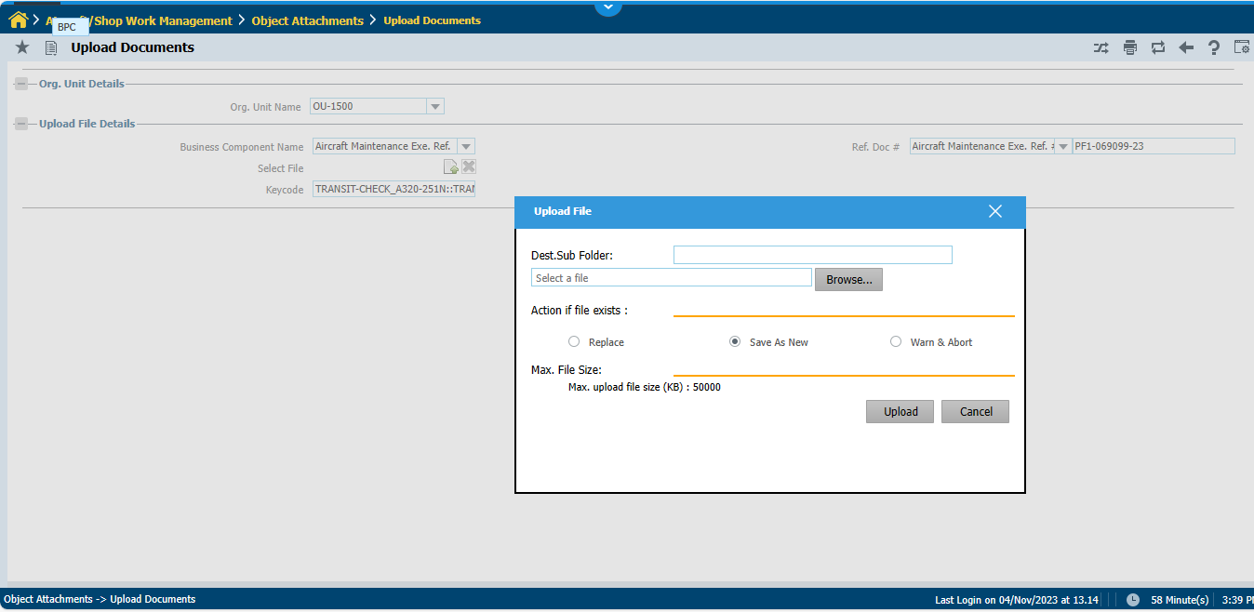
FILE NAME MUST BE NAMED AS PACKAGE NUMBER, SAY PF_XXXXXX_23, ONLY. No special characters except underscores ( _ )
If the pdf file name is too long, it will
_show an error, then try once more to
_override the error message. Or else
_shorten and simplify the name and retry.
Error Message
JOB CARDS NEED NOT BE UPLOADED

Slide 32
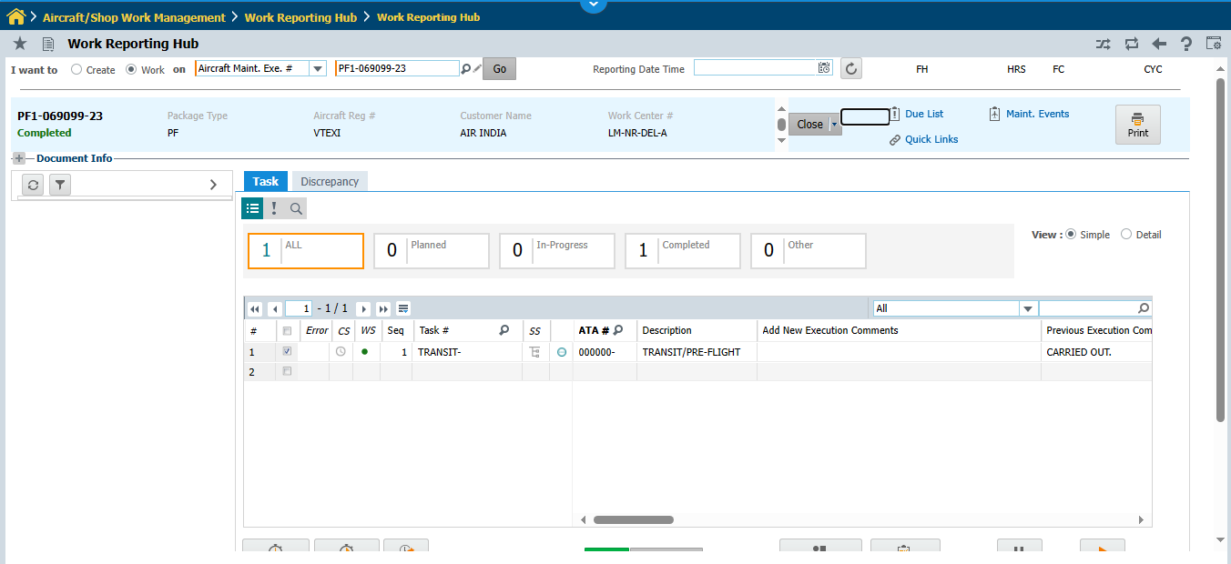
Closing the Package
After completion of tasks
We can close the package.

Slide 33
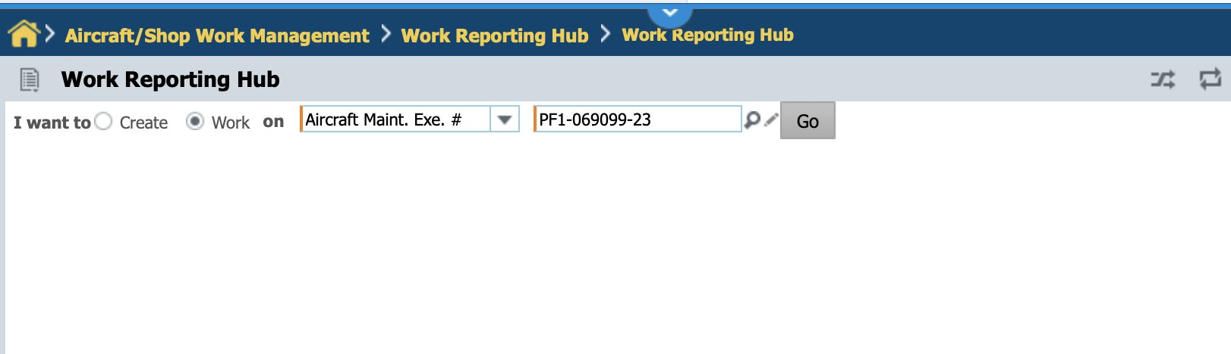
Working on an Existing Package
Use search lens to identify a package (in -planned, -progress, or complete) status.
Note: The packages in the closed status are removed from the
User’s view.

Slide 34
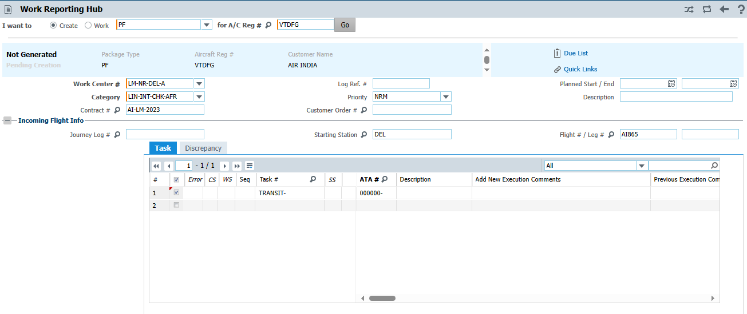

Slide 35

Component Replacement

Slide 36
Path to component replacement updation

Slide 37
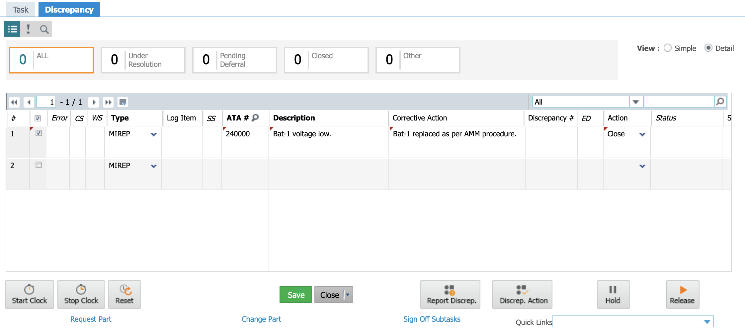
Close the Discrepancy
Detail View
P.No…
OFF#
ON#
Add OFF P/N OFF S/N in detail view column
Update P/N OFF# ON #
in the corrective action

Slide 38
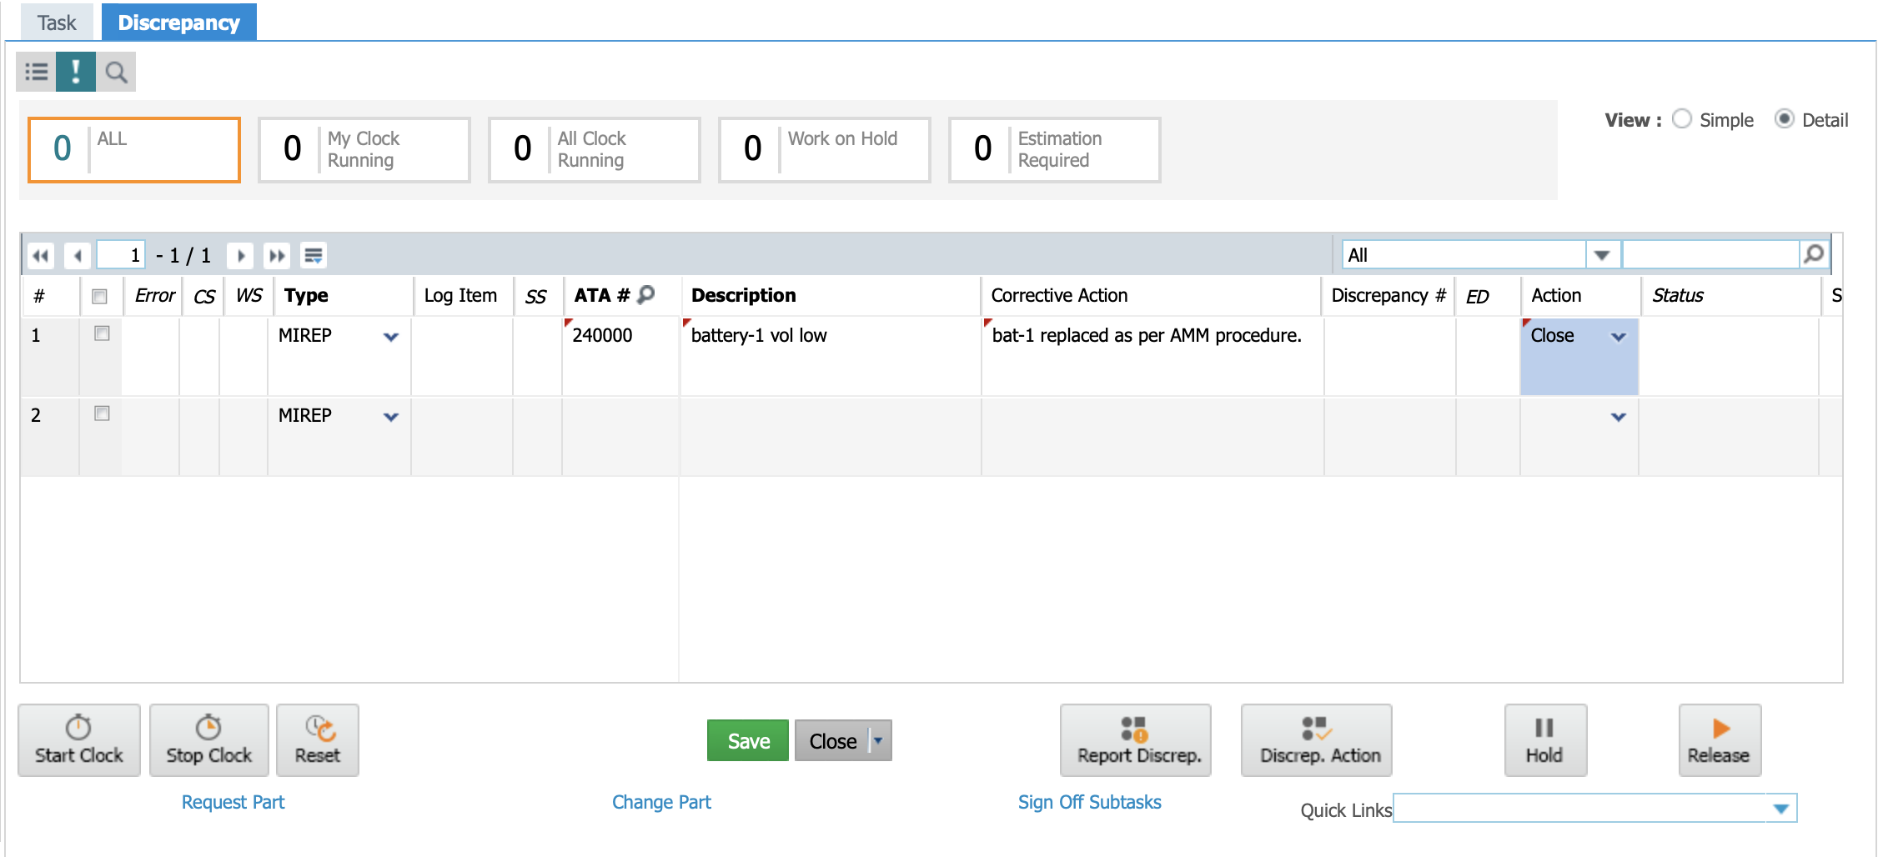
Closing a Discrepancy
✅Tick this!
Select close and Press Save!
Or directly press Close

Slide 39
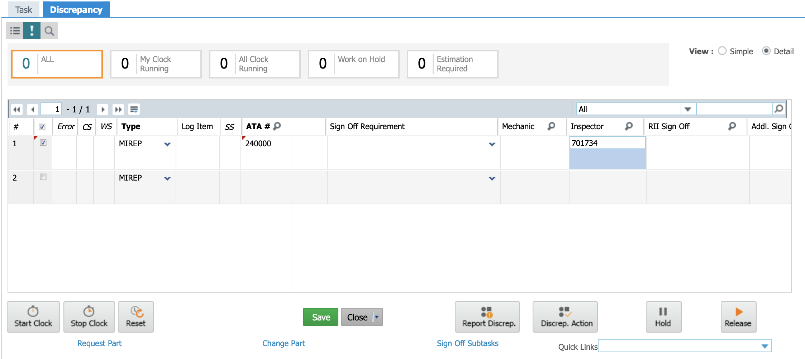
Inspector (AME) sign off in the Discrepancy
Here it is!

Slide 40
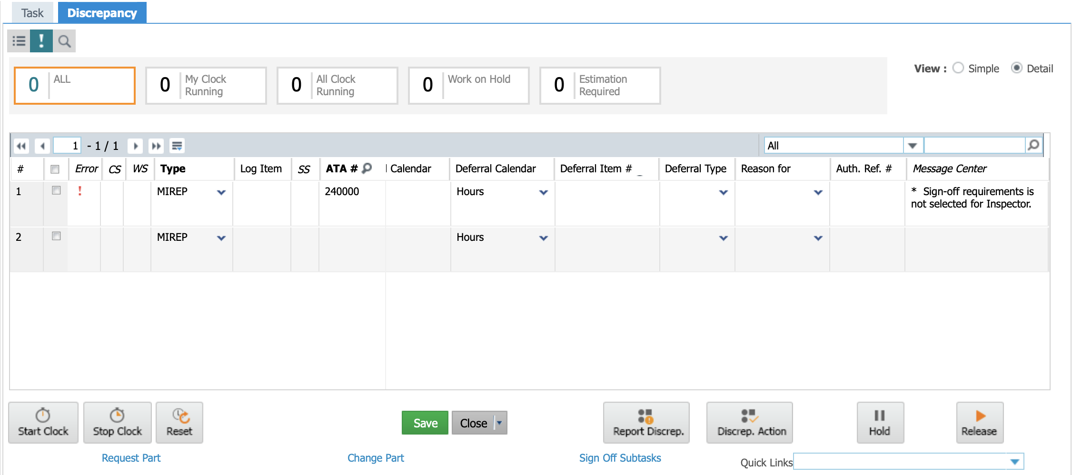
Where to See the Errors

Slide 41
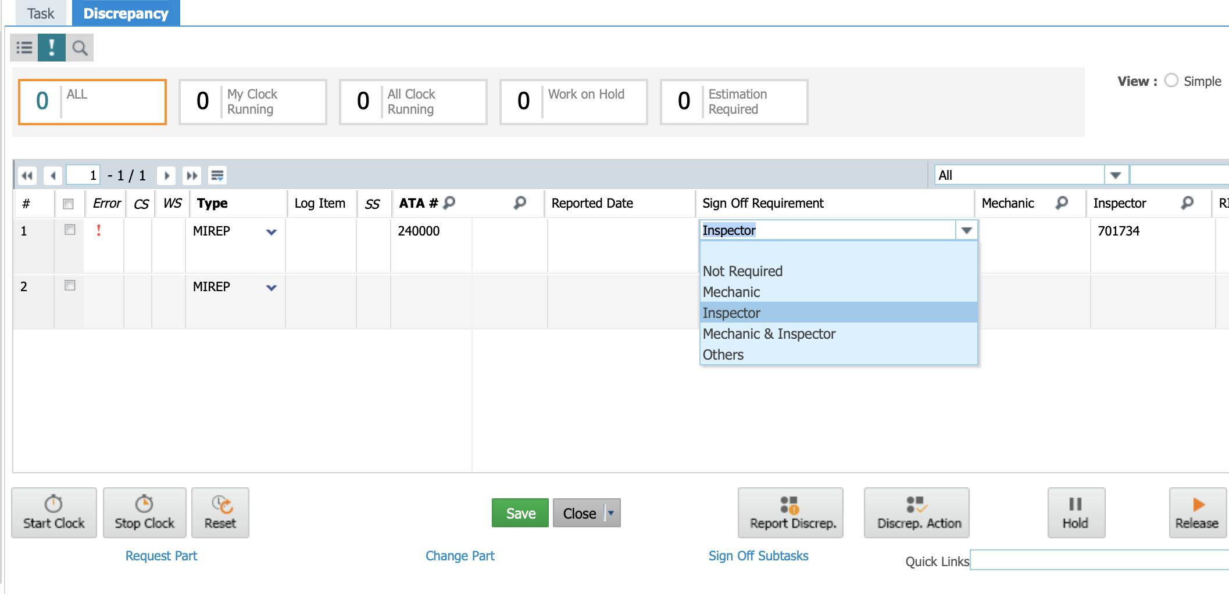
Sign off Requirement

Slide 42
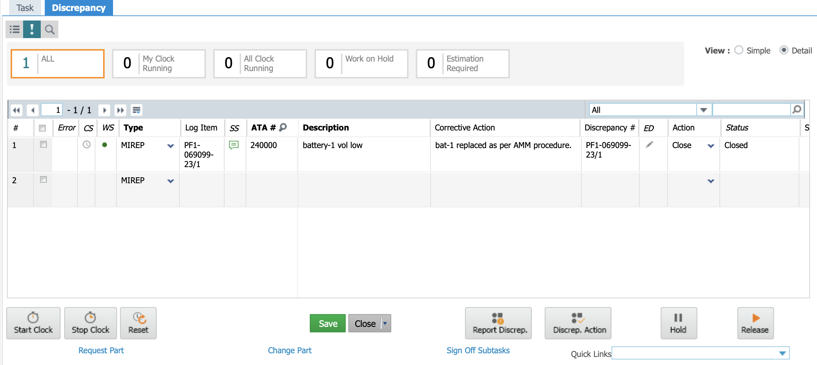
Successfully Closed, Green Dot
See here!
Discrepancy no.

Slide 43
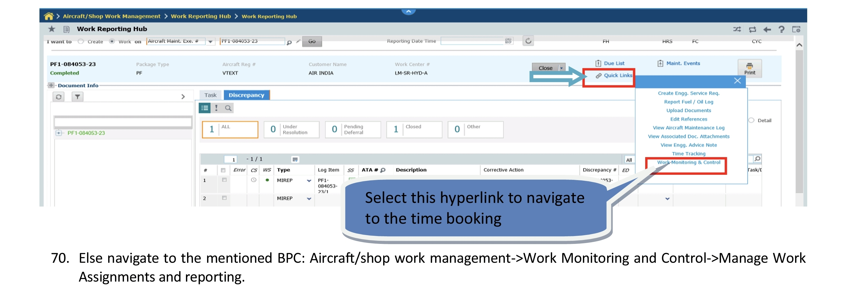
Work Monitoring and Control

Slide 44
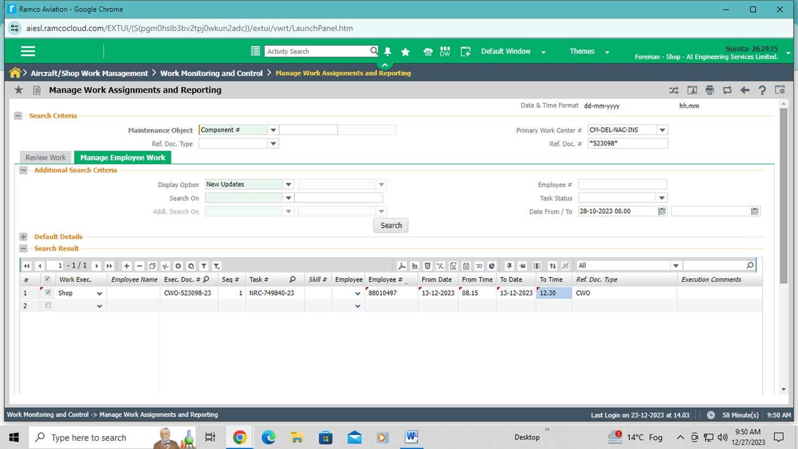
Work Monitoring and Control, for Shop

Slide 45
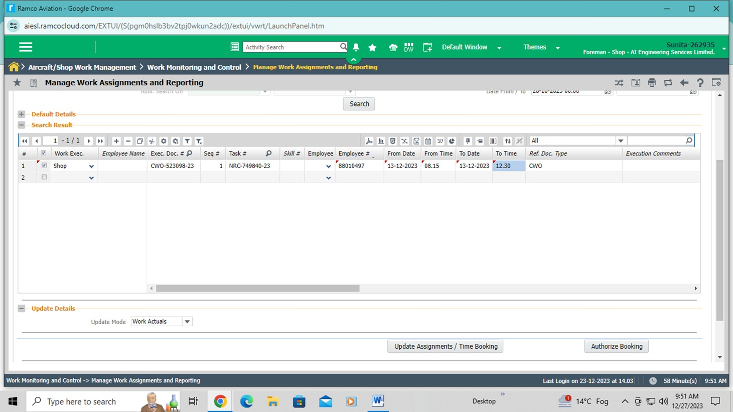
For Shop, Cont’d

Slide 46
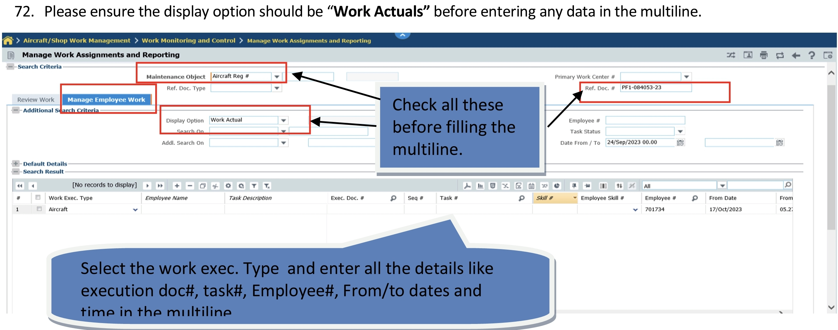
For Line/Base Maintenance

Slide 47
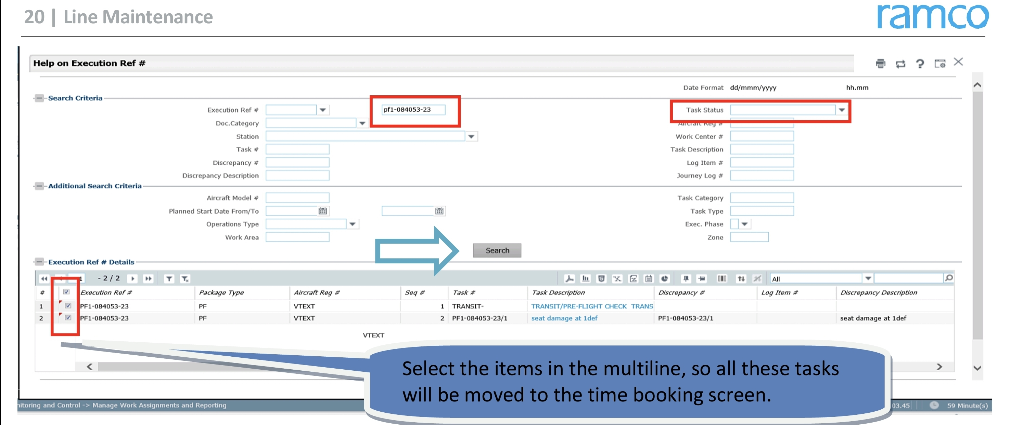
For Line/Base Maintenance, cont’d
IGNORE ITEM 1, NOT REQ’D FOR “TASK” IN LINE OR BASE. ONLY DISCREPANCIES ARE REQUIRED
FOR MANHOURS CALCULATIONS. Also it’s entered against Technician only, not for AME.

Slide 48
For Line/Base Maintenance, cont’d

Slide 49
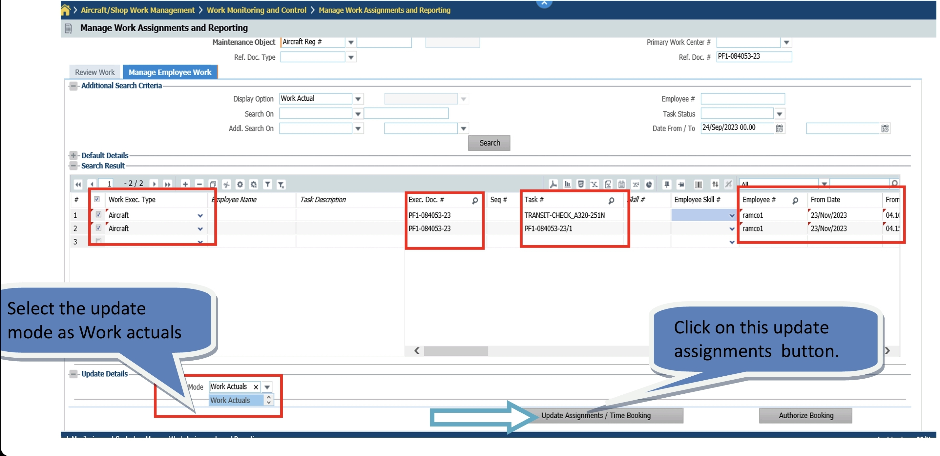
For Line/Base Maintenance, cont’d

Slide 50

Generation of Non Routine Card

Slide 51
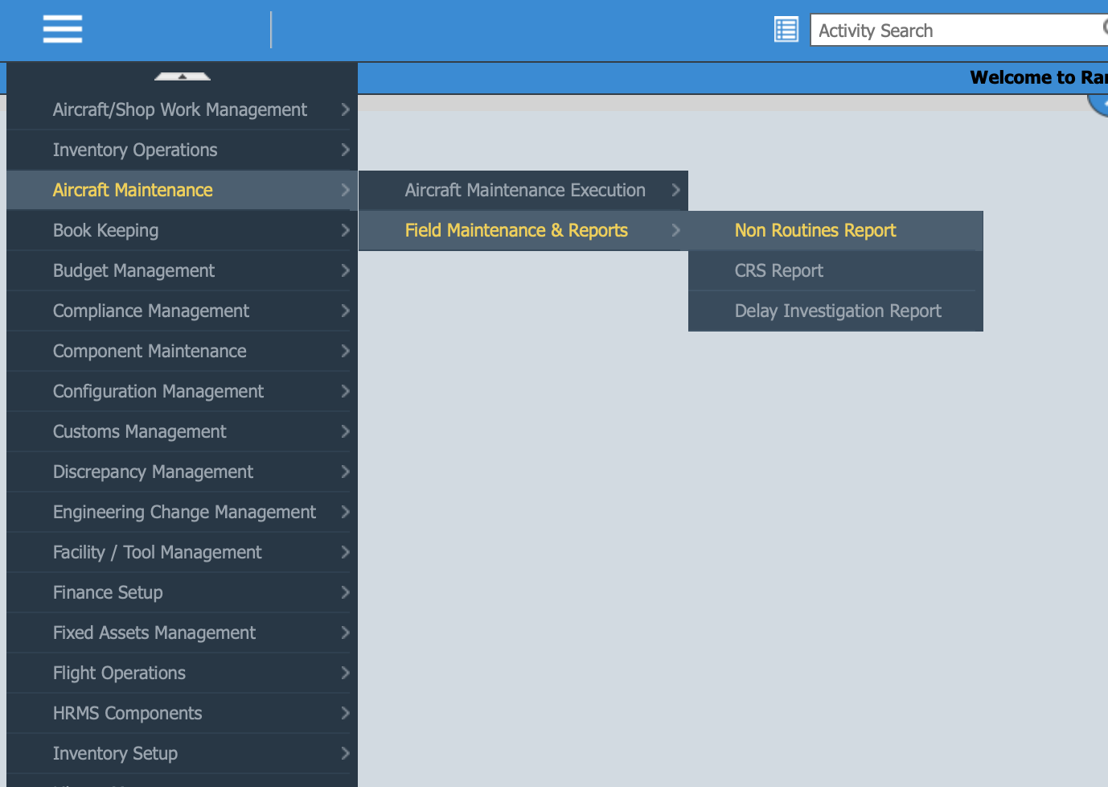
Go to HOME

Slide 52
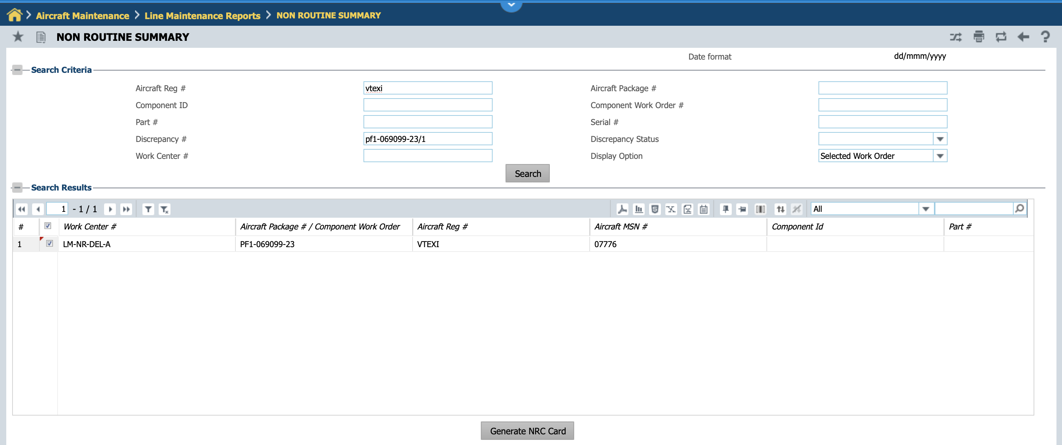
Supply the necessary inputs and generate NRC

Slide 53
Voila! Our First Production ☺
the P. No, Off#, ON# details
will be printed there

Slide 54
SHOP PROCESS CHANGE

Slide 55
SHOP PROCESS CHANGE
For operator’s issued item
MR, MRN for spares not required. Only main core MRN required.
Assembly/Dis-assembly not required
Spare replacement details to be updated in discrepancy.
Use NRC report to generate discrepancy report and sign.
Spare to be returned with manual removal Tag with all details.
For AIESL store issued item
complete process of MR, MRN to be used.

Slide 56
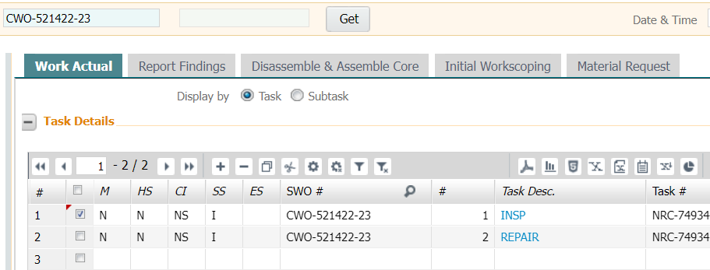
Add discrepancy

Slide 57
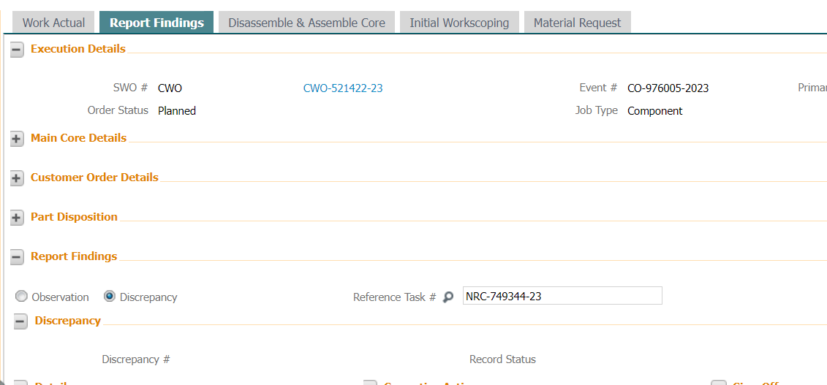
Add discrepancy

Slide 58
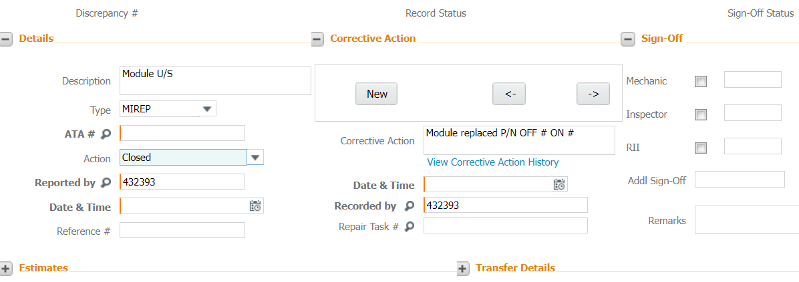
Add discrepancy
Update P/N OFF# ON# in corrective action

Slide 59
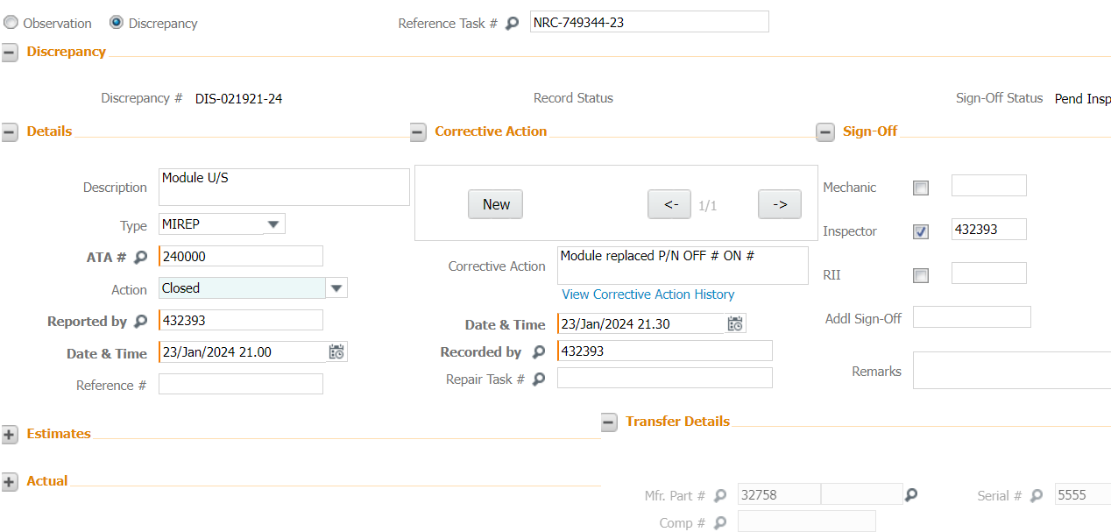
Add discrepancy

Slide 60
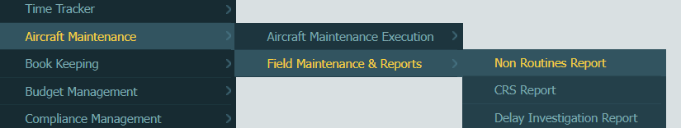
Generate NRC Report

Slide 61
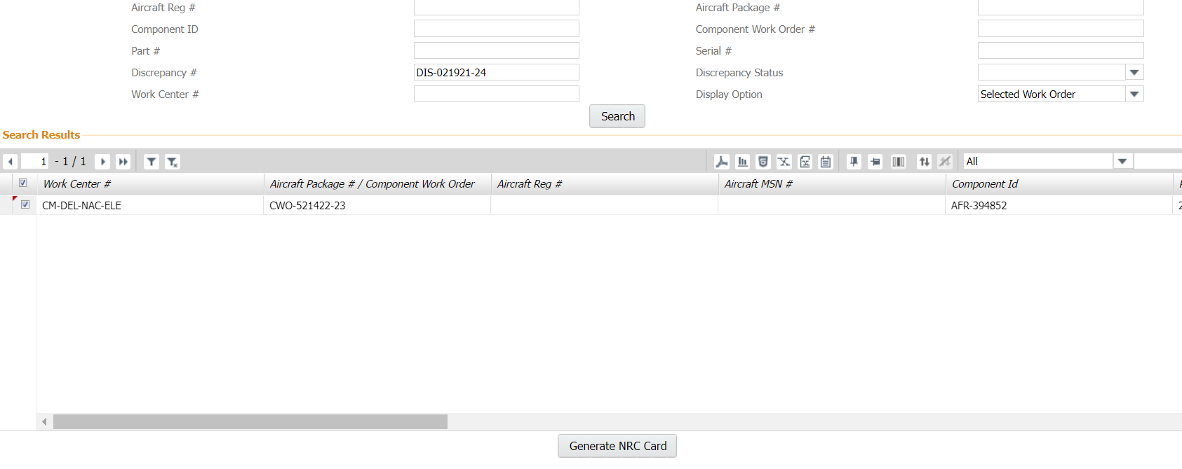
Generate NRC Report

Slide 62
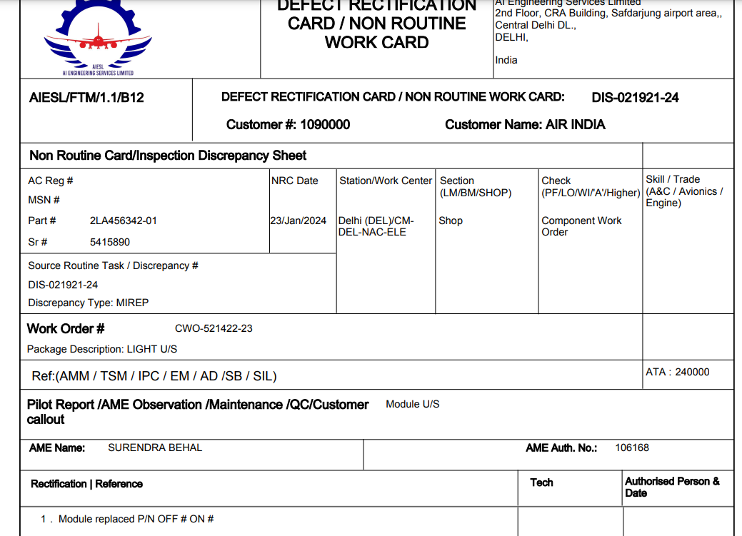

Slide 63

Useful Forms:

Slide 65
S/N | STATION | ACTIVITY CENTER | NAME | DESIGNATION | EMAIL | CONTACT NO.
 | DEL GRP-A | BASE MAINT | SUNIL KR TOOR | AGM | sunil.kumar7@aiesl.in | 9871800598
 | DEL GRP-A | LINE MAINT | ASHOK CHAWDHARY | DGM | ashok_ail@yahoo.co.in | 9818271868
 | DEL GRP-A | PROGRESS | AZIM ANSARY | SR.AGM | azim.ansari@aiesl.in | 9818113489
 | DEL GRP-A | SHOP | VIVEK GOEL | AME | vivek.goel@aiesl.in | 9873773004
 | DEL GRP-A | JEOC | MANISH DUNEJA | SR.AGM | manish.duneja@aiesl.in | 9811179939
 | DEL GRP-B | LINE MAINT | G K SRIVASTAVA | AGM | gk.srivastav@aiesl.in | 9910228837
 | DEL GRP-B | JET SHOP | RAVINDRA R JOSHI | SR.AGM | ravindra.joshi@aiesl.in | 7045946725
 | CCU | LINE MAINT | SUDIP ADAK | SR.AME | Sudip.adak@aiesl.in | 9830126019
 | CCU | BASE MAINT | RAJEN MECH | MANAGER | bmmeraiesloffice@gmail.com mechrajenmr@gmail.com | 8240671045
 | CCU | PROGRSS | TAPAS KUMAR RAY | OFFICER (CON) | tkrbaniara@gmail.com | 9674523212
 | CCU | SHOP-AV | PREMANSU KUMAR DAS | AGM | premansu.das@aiesl.in | 9830182969
 | CCU | SHOP-AF | RUPA DAWN PAUL | SUPERVISOR | dawnrupa@gmail.com | 9883436443
 | CCU | SHOP-APU | SANJIT MURMU | A/C TECH | sanjitmurmu22@gmail.com | 9073531679
 | MAA | LINE MAINT | A C VENUGOPAL | SR.AGM | vgopal.chellappa@aiesl.in | 9884003774
 | MAA | PROGRESS | S TAUHEED AHAMEED | SPRVSR- STORES | stores.maa@aiesl.in | 9655959927
 | HYD | COMPONENT O/H | Y RADHIKA | SR.AGM | yerram.radhika@aiesl.in | 9440401739
 | HYD | LINE MAINT | M S MURTHY | SR.AGM | suresh.murty@yahoo.com | 7730090909
 | HYD | BASE MAINT | G HANGI | SR.AGM | gugu.hangi@aiesl.in | 9703847099
 | HYD | PROGRESS | MAHMAD MAHAMOOD | SR.AGM | mahmad.mahamood@aiesl.in | 9494489654
 | HYD | SHOP | G DEVI SINGH | SR.AGM | devising.gugulothu@aiesl.in | 9441666878
 | TRV | LINE MAINT | AJMEER KHAN | L/M MGR | ajmeer.kasim@aiesl.in | 9444178787
 | TRV | LINE MAINT | SHILSAGAR PRAKASH BANSODE | AE | s.bansode@aiesl.in | 8108159747
 | TRV | BASE MAINT | AVINASH SHETTY | BMM | avinash.shetty@aiesl.in | 7977948767
 | TRV | PROGRESS | R AHILARAJAN | PPM | r.ahilarajan@aiesl.in | 9895422025
 | TRV | SHOP MAINT | MONTO NATH | SMM | smm.tr@aiesl.in | 8129766831
 | NAG | BASE MAINT | SHIMPI VP | AGM | vp.shimpi@aiesl.in | 9967030721
 | NAG | PROGRESS | PRAMOD SAHU | SR.AGM | pramod.sahu@aiesl.in | 9868503771
 | BLR | LM / PROGRESS | ANTONY RICHARD | AE-SS | antony.richard@aiesl.in | 9747465296
Nodal persons for AIESL RAMCO implementation at Line Maint & Base Maint, Progress, Shop Activity Center

Slide 66

Ramco Help Desk
Issues of Workstation mapping, login password issues, all sorts of mapping or authorization rights for transactions.
itmroadmin@aiesl.in

Slide 67

Questions
Thanks 😀

